Slide 1
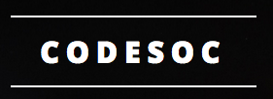
Machine learning in python
Tom Galligan
Mathematical Institute and Department of Physics
Brasenose College
thomas.galligan@bnc.ox.ac.uk

Slide 2
Prerequisites
To get the most out of this course, you should:
Have a basic understanding of programming (this course will use Python)
Have preinstalled the required software onto your laptop, which you can bring to each session
Be comfortable with basic maths and statistics

Slide 3
Introduction: What is machine learning?
Teaching computers to perform a particular task
As proficiently as possible
Without explicit programming

Slide 4

What is machine learning not?
Teaching computers to “think”
“Just glorified statistics”
Capable of inferring causation
Magic
© SandSerif Comics

Slide 5
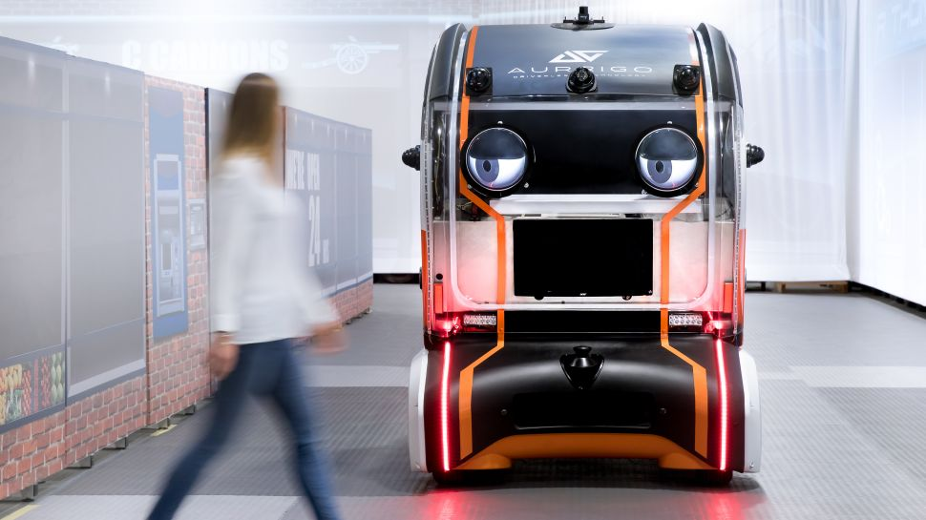
Machine Learning in practice
Jaguar/Land Rover

Slide 6

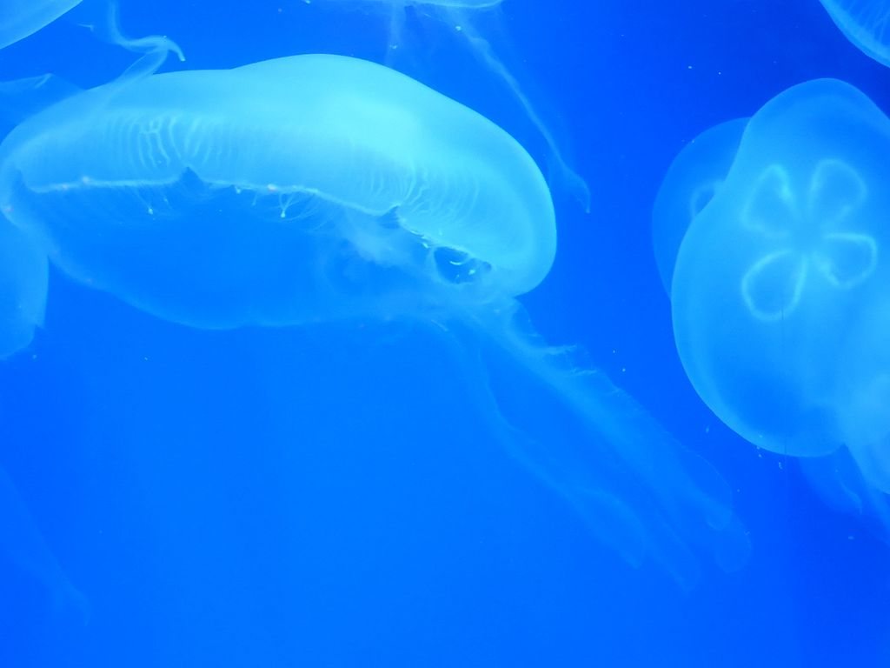
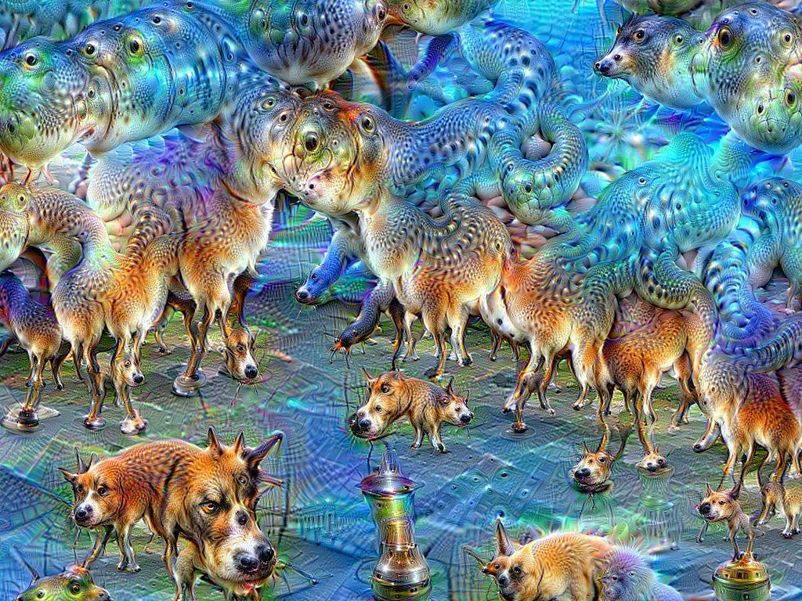
https://deepdreamgenerator.com/

Slide 7
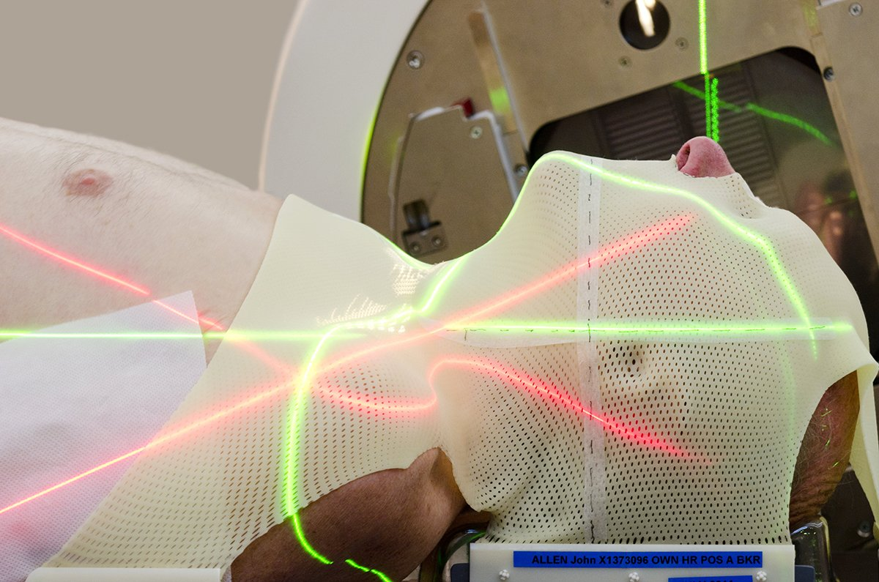
Image credit: Google DeepMind Health – radiotherapy planning

Slide 8
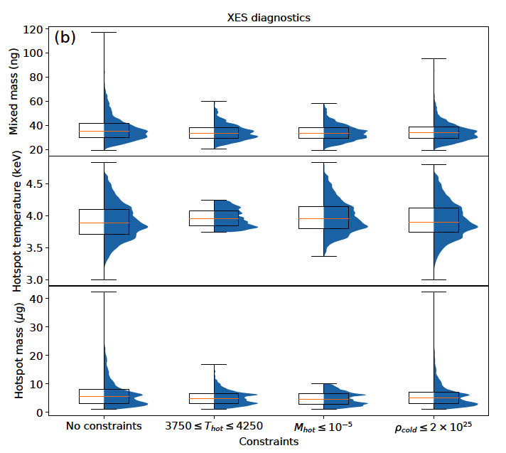
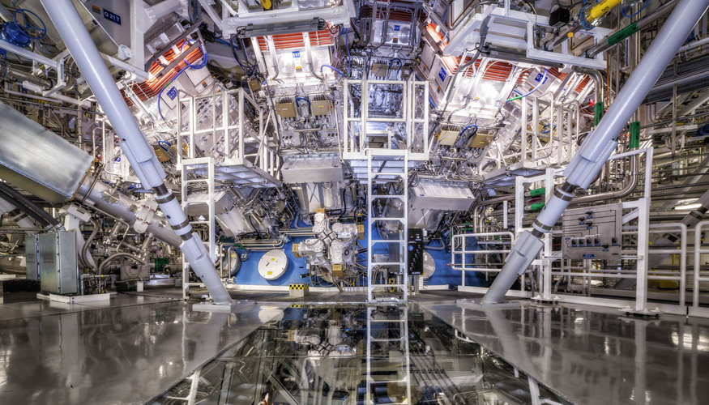
PHysics
Image Credit: Damien Jameson/LLNL
Kasim, Galligan et al., (submitted)
(2018)

Slide 9
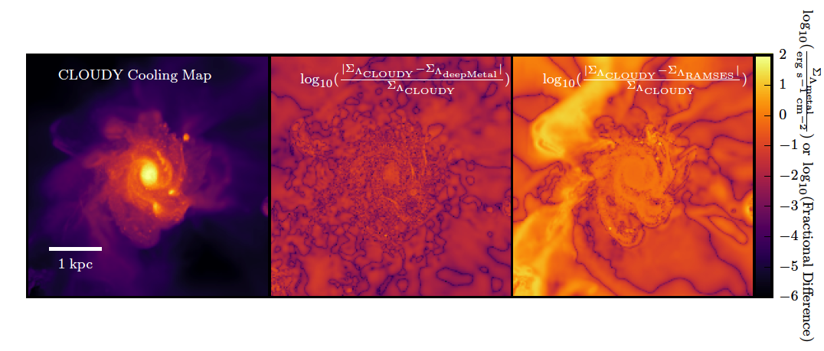
physics
Galligan & Katz, MNRAS (2018) (in prep)

Slide 10
The goal of a machine learning algorithm
We have an object that belongs to one of several categories.
The category it’s in depends on certain parameters (features)
We don’t know the relationship between the features and the form of the object
BUT we have lots of examples of this object, its features and what category each example belongs to!
Can we train an algorithm on these examples and get it to accurately predict the categories of new object.
Inputs (features)
ML Algorithm
Output(s)

Slide 11
Some terminology
Feature
Feature space
Prediction
Hyperparameter
Hyperparameter space
Training set
Test set
Cost function

Slide 12
CLASSIFICATION VS REGRESSION

Slide 13
K-Nearest neighbors
k | Prediction for
1
3
5
7
9
11

Slide 14
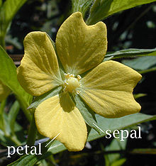
Iris data set
Database of 150 flowers
3 species of flower:
setosa (0)
versicolor (1)
virginica (2)
4 features:
Sepal length
Sepal width
Petal length
Petal width

Slide 15
The importance of scaling
Many ML algorithms are sensitive to the scale of the data.
KNN is particularly vulnerable to this – sepal widths are much smaller than petal widths, so they will count more than they should!
To get round this, scale the data in each dimension to have mean 0 and variance 1.

Slide 16
K-fold Cross validation
Can we tune hyperparameters to improve the accuracy of our algorithm?
Dataset
Training Data
Fold 1
for j in 1…k
use {1,…,k} \ {j} as training set
evaluate performance on fold j
Fold 2
…
Take average of the k performances to estimate accuracy of the model.
Repeat this process for each model you want to test (generally grid search over hyperparameter space).
Fold k
Test data
Random split
Notes:
Reshuffle for each model

Slide 17
Notes:
Best fit is at k=7

Slide 18
Notes:
Talk about overfitting here

Slide 19
Summary
KNN is one of the simplest machine learning algorithms, but it can be very accurate
Think carefully about scaling!
In general not suitable for very high-dimensional feature spaces
Lazy-learner, no real training happens (the data is the algorithm)

Slide 20
Challenge – boston house prices
There are 14 attributes in each case of the dataset. They are: CRIM - per capita crime rate by town
ZN - proportion of residential land zoned for lots over 25,000 sq.ft.
INDUS - proportion of non-retail business acres per town.
CHAS - Charles River dummy variable (1 if tract bounds river; 0 otherwise)
NOX - nitric oxides concentration (parts per 10 million)
RM - average number of rooms per dwelling
AGE - proportion of owner-occupied units built prior to 1940
DIS - weighted distances to five Boston employment centres
RAD - index of accessibility to radial highways
TAX - full-value property-tax rate per $10,000
PTRATIO - pupil-teacher ratio by town
B - 1000(Bk - 0.63)^2 where Bk is the proportion of black citizens by town
LSTAT - % lower status of the population
MEDV - Median value of owner-occupied homes in $1000's
https://www.cs.toronto.edu/~delve/data/boston/bostonDetail.html
Notes:
Plot mean_squared_error against k

Slide 21
Class 2: random forests
Last Time
Explored k-Nearest Neighbors algorithm
Works well for low-dimensional feature spaces (flower identification)
Not so good on high-dimensional problems (Boston Housing Prices)

Slide 22
The Bias-variance trade-off
Bias: missing important relations between features and targets (outputs)
Variance: overfitting – finding relationships that aren’t there (modelling noise)
As you increase complexity of the model,

Slide 23
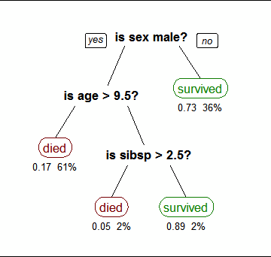
Decision trees
Building blocks of random forests
Simple learning algorithms - produces output from several inputs.
Deep trees are needed to deal with complex problems, but deep trees tend to overfit
Low bias, high variance
Is there a way to fix this?
Wikipedia (Stephen Millborrow)

Slide 24
Tree bagging
Say we have a training set of n feature sets X ={x₁,…,x_{n}} and n targets Y = {y₁,…,y_{n} }
for b in 1,…,B:
sample (with replacement) n training examples from X and Y. Call these X_{b} and Y_{b}.
create a decision tree T_{b} that has been trained on {X_{b},Y_{b}}
Classification
Regression
Take majority output from all of the trees
Take an average over all of the trees
Notes:
One decision tree tends to have very high variance
Can we average over lots of them to reduce the variance somehow?
General algorithm for random forests is boostrap aggregrating, or bagging.

Slide 25
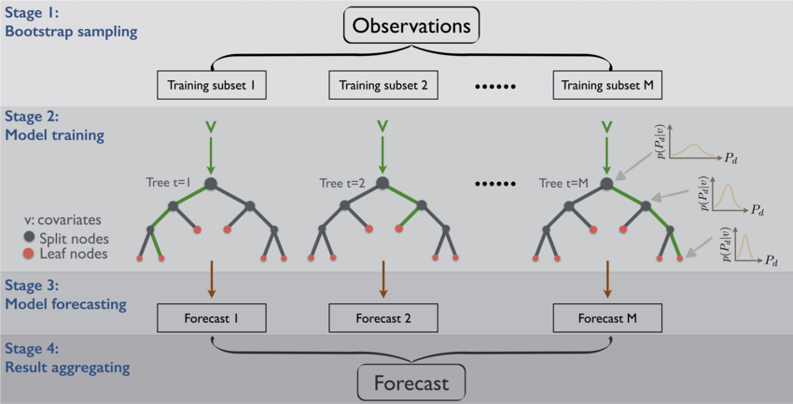
He et al. 2016

Slide 26
Why do we boostrap?
Decorrelates the trees
Reduces sensitivity to noise
Decreases variance without large increase in bias.
How do we know how many trees we need?
Cross validation!
Or... Out-of-bag error
How do you actually train a tree?
Notes:
Out of bag: what’s the mean prediction error on each training sample, using only trees that didn’t have that sample in their bootsrap set.
Mention feature bagging – helps to reduce correlation by only training trees on random subsets of the features.

Slide 27
Random forest hyperparameters
n_estimators: number of trees in the forest
max_features: The number of features to consider when looking for the best split
max_depth: maximum depth of the trees
Bootstrap: whether to do boostrap sampling or not
Notes:
Show what happens if you don’t bootstrap!

Slide 28
Feature importance
Permute the values of each feature among the training data
Recalculate OOB error
Repeat over all trees
Average over all trees, divide by std dev to get importance score
Tries to extract ‘real’ information from the statistics!

Slide 29
Optimised knn

Slide 30
Boston house prices – Take 2

Slide 31
Challenge: Breast cancer dataset
Download the set with
from sklearn.datasets import load_breast_cancer
X, y = load_breast_cancer(return_X_y = True)
Create a random forest algorithm that predicts whether a tumour is benign (0) or malignant (1) as accurately as possible.
What are the most important features of the tumour?

Slide 32
Random forests - summary
Random forests are tolerant to feature scaling! – no need to transform data (though it’s still good practice)

Slide 33
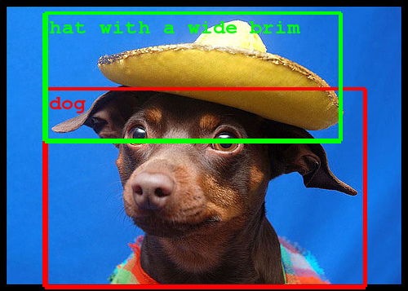
Class 3 – introduction to neural networks and deep learning
Taken from the Google Blog.

Slide 34
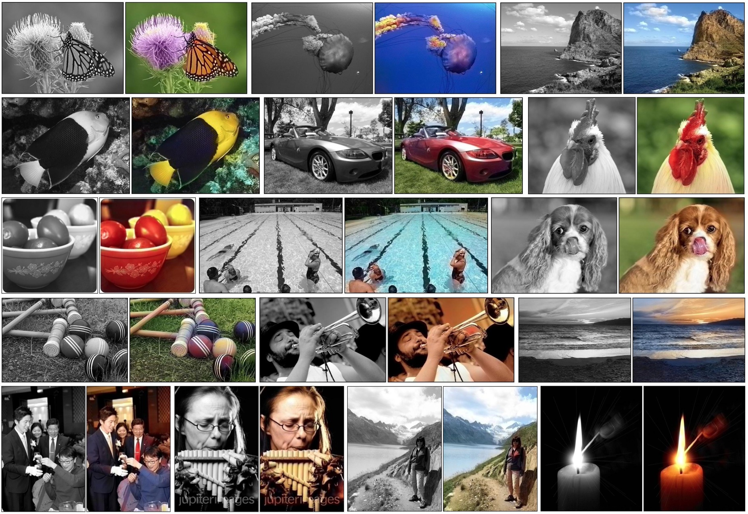
Image taken from Richard Zhang, Phillip Isola and Alexei A. Efros.

Slide 35
What is a neural network?
Collection of nodes with connections between them.
Each connection has:
Weight
Bias
Activation function

Slide 36
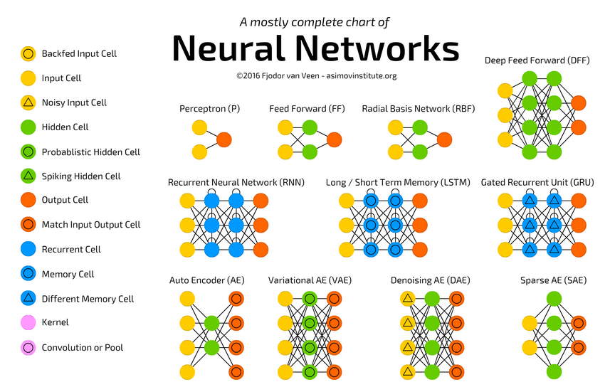

Slide 37
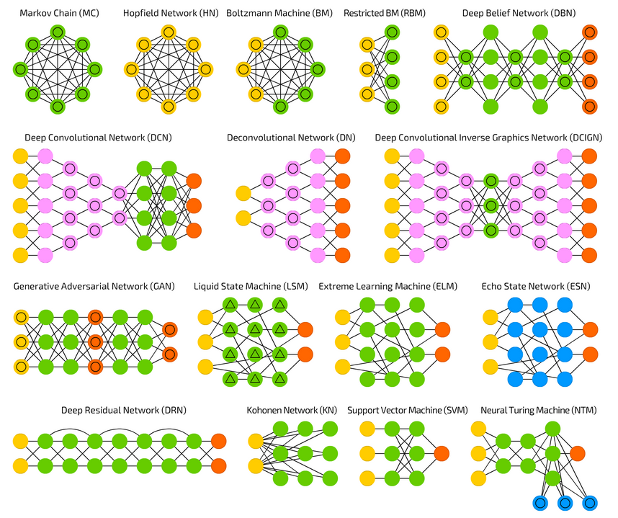

Slide 38
Feed forward neural networks
Input layer
Output layer
Hidden layers

Slide 39
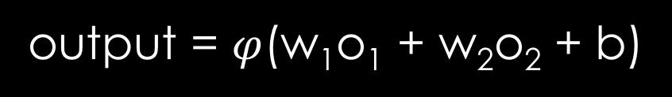
o₁
w₁
?
output = $φ$(w₁o₁ + w₂o₂ + b)
o₂
w₂

Slide 40
Activation functions
Introduce non-linearity into the model
Best option in general: ReLU
“Almost linear”
Preserves the easy optimisation of linear models while allowing for non-linearity.
We can build a universal function approximator from ReLU functions (!)

Slide 41
Universal approximation theorem

Slide 42
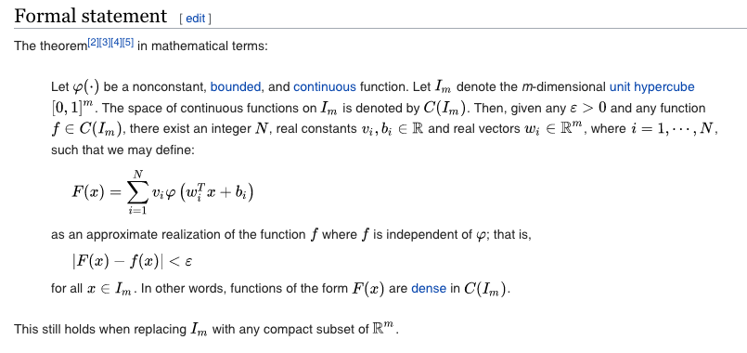
https://en.wikipedia.org/wiki/Universal_approximation_theorem

Slide 43
Feed forward neural networks
Input layer
Output layer
Hidden layers

Slide 44
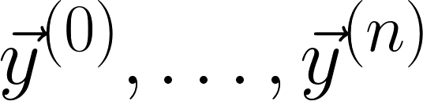
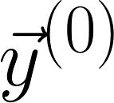
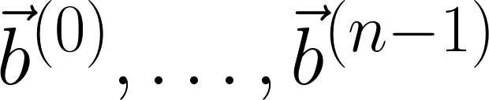
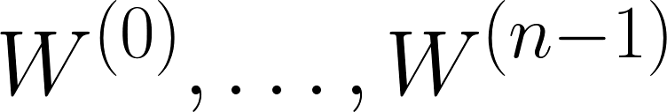
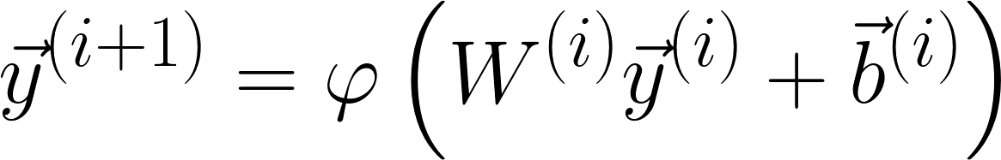
More mathematically:
Write layers as vectors: - we only know to begin with
Write biases as vectors:
Write weights as matrices:
Calculate the node values iteratively:

Slide 45
Training - backpropagation

Slide 46
How do we prevent overfitting?
Limit number of epochs
Dropout: set a fraction of your nodes to zero output
Reduce complexity of your architecture
Get more data!

Slide 47
General good practice
How is your data going to arrive at the neural network? What kind of preprocessing do you need to do?
Look at popular recent architectures – what works well?
Think about the problem you’re trying to solve: is a feedforward network really the best option for image classification?
Beware of overfitting!
Think about generalisability and edge cases
Always train on a GPU if you have one available

Slide 48
Next time:
Convolutional Neural Networks
Derivative-free optimisation
Natural Language Processing
Backpropagation in depth
Bayesian methods
…?

Slide 49
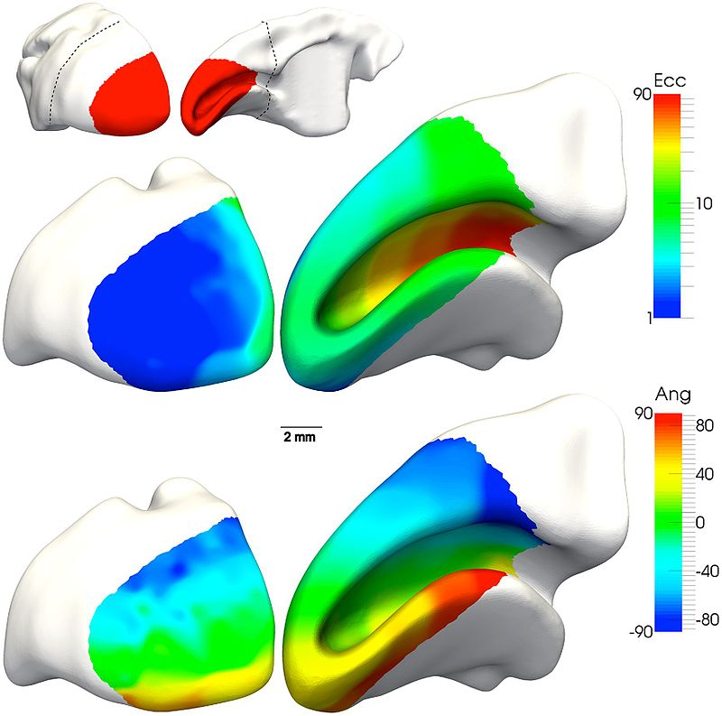
Chapter 4: Convolutional Neural Networks
Solomon SG and Rosa MGP (2014) A simpler primate brain: the visual system of the marmoset monkey.

Slide 50
Last time: fully connected feedforward neural nets
Input layer
Output layer
Takes in a vector
Outputs a vector (or a scalar)
Not great for images – dimensionality problem
Hidden layers

Slide 51
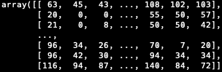
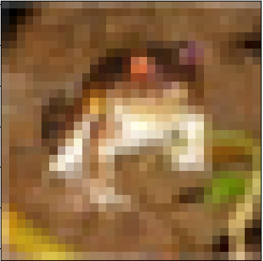
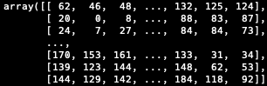
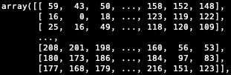
Structure of an image
https://www.cs.toronto.edu/~kriz/cifar.html

Slide 52
Convolutional neural networks
Specifically designed for image recognition
Takes in multi-dimensional arrays (tensors) rather than just vectors
Cares about neighbors in inputs, rather than treating each feature completely separately.

Slide 53
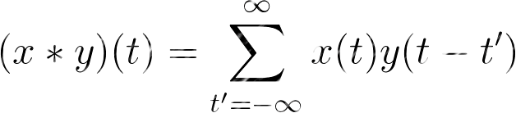
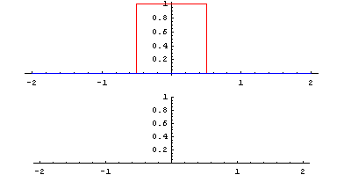
convolution
x: input
y: filter
https://giphy.com/gifs/processing-signal-kcchao-wunmqxMZ8XtsY

Slide 54
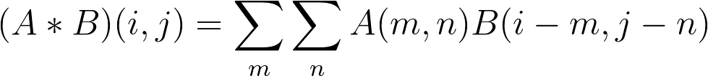
Convolution of arrays
*
=
Output
Filter
Input
https://www.deeplearningbook.org/

Slide 55
Zero padding
0 | 0 | 0 | 0 | 0 | 0
0 |  |  |  |  | 0
0 |  |  |  |  | 0
0 |  |  |  |  | 0
0 |  |  |  |  | 0
0 | 0 | 0 | 0 | 0 | 0
Avoids reduction in array size with each convolution

Slide 56
pooling
Cluster of neuron outputs in one layer becomes a single output in the next layer.
Reduces risk of overfitting
4 | 2 | 7 | 1
3 | 8 | 2 | 5
9 | 2 | 2 | 4
10 | 2 | 3 | 6
8 | 7
10 | 6
Max pooling

Slide 57

Dropout
In a given layer, set a proportion p of the neurons equal to zero.
General rule of thumb is p ~ 0.2, but you can cross-validate this.
Reduces overfitting – fewer parameters to train on
Stops the network caring too much about some neurons.

Slide 58
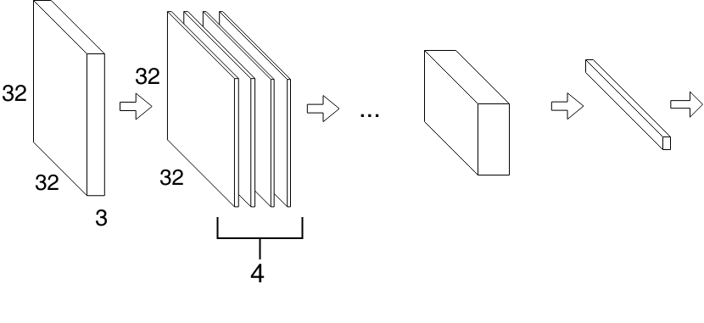
CNN architecture
CNNs can be extremely deep
Deeper networks can pick up more complex features in the image
Remember to zero pad
As you go deeper, increase the number of filters in the each convolution layer
Output
Vector
Fully connected network
Convolution,
Dropout
Pooling…
Input
Convolution
(4 filters)

Slide 59
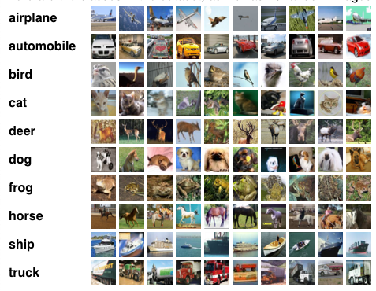
Cifar10 dataset
60,000 32x32 color (RGB) images
10 categories
https://www.cs.toronto.edu/~kriz/cifar.html

